Slide 1
Context Free Grammar (CFG)
Context Free Languages (CFL)

Slide 2
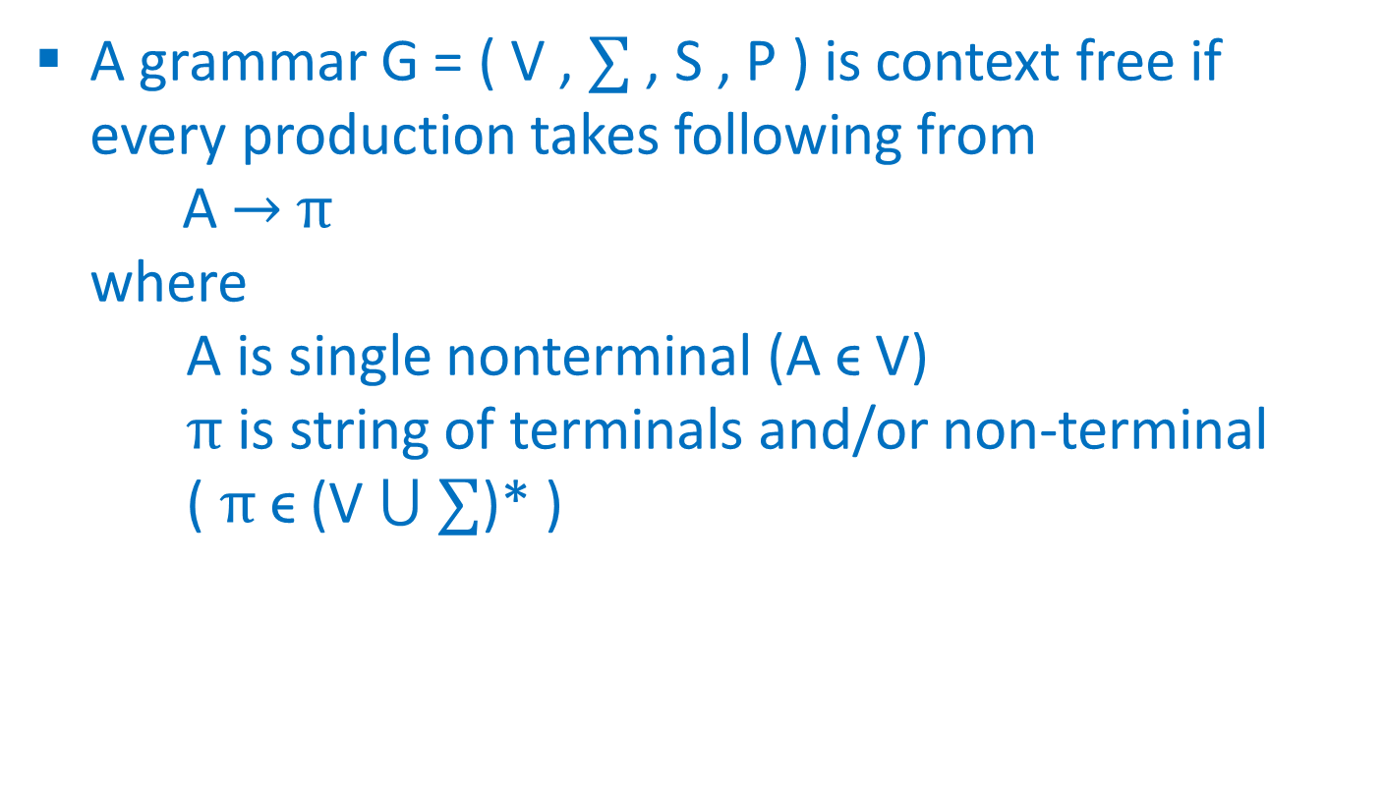
Definition of CFG
A grammar G = ( V , ∑ , S , P ) is context free if every production takes following from
A → $π$
where
A is single nonterminal (A ϵ V)
$π$ is string of terminals and/or non-terminal
( $π$ϵ (V $⋃$ ∑)* )

Slide 3
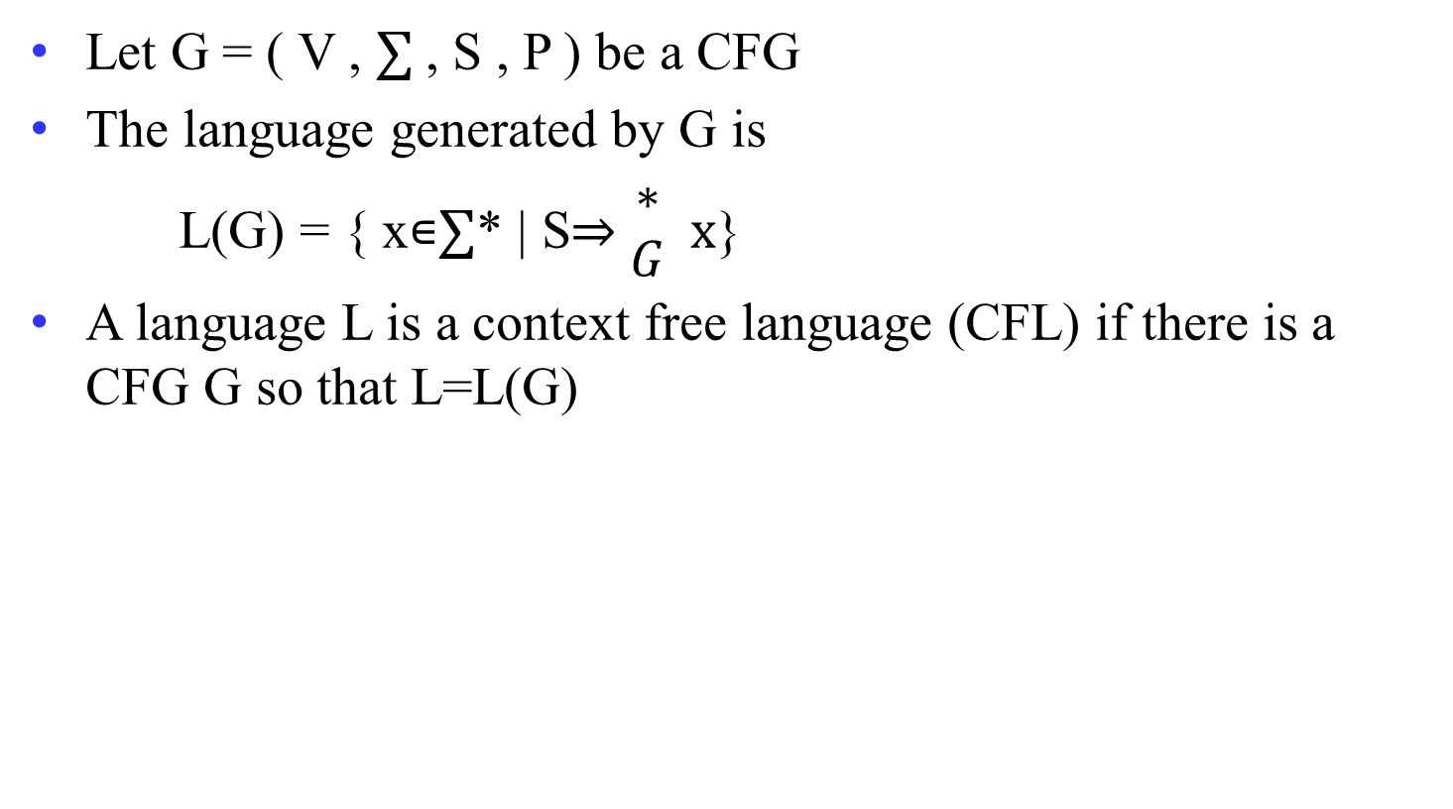
Definition of CFL
Let G = ( V , ∑ , S , P ) be a CFG
The language generated by G is
L(G) = { x∊∑* | S⇒ $\begin{matrix}∗ \\ G\end{matrix}$ x}
A language L is a context free language (CFL) if there is a CFG G so that L=L(G)

Slide 4
Grammar for given RE
a*
S → aS | ʌ
( a + b )*
S → aS | bS | ʌ
( a + b )⁺
S → aS | bS | a | b
( a + b )* aa ( a + b )*
S → XaaX
X → aX | bX | ʌ
a*b*
S → XY
X → aX | a | ʌ
Y → bY | b | ʌ

Slide 5
Grammar for given RE
ab*
S → aX
X → bX | ʌ
a*bb
S → Xbb
X → aX | ʌ
a ( a + b )*
S → aX
X → aX | bX | ʌ
(a+b)* a (a+b)*a (a+b)*
S → XaXaX
X → aX | bX | ʌ

Slide 6
Grammar for given RE
( baa + abb )*
S → baaS | abbS | ʌ
(011 + 1)* (01)*
S → BC
B → AB | ʌ
A → 011 | 1
C → DC | ʌ
D → 01
( aaa + b )*
S → aaaS | bS | ʌ
( aa + bb )⁺
S → aA | bB
A → aS | a
B → bS | b

Slide 7
Grammar for given Languages
L = { x | n₀(x) = n₁(x) }
S → 0S1S | 1S0S | ^
L = { x | n₀(x) ≠ n₁(x) }
S → A | B
A → 0 | 0A | 1AA | AA1 | A1A
B → 1 | 1B | 0BB | BB0 | B0B

Slide 8
Grammar for given Languages
L = { w | w∈{0,1}* and w starts and ends with the same symbol}
S → 0X0 | 1X1 | ʌ
X → 0X | 1X | ʌ
L = { w | w∈{0,1}* and |w| is odd}
S → 0X | 1X
X → 00X | 01X | 10X | 11X | ʌ

Slide 9
Grammar for given Languages
L = { a^{n} b^{n} | n ≥ 0 }
S → aSb | ʌ
L = { a^{n} b a^{n} | n ≥ 0 }
S → aSa | b
L = { a^{4n} | n > 0 }
S → aaaaX
X → aaaaX | ʌ

Slide 10
Grammar for given Languages
L = even length palindrome stings
S → aSa | bSb | ʌ
L = odd length palindrome strings
S → aSa | bSb | a | b
L = palindrome strings
S → aSa | bSb | a | b | ʌ

Slide 11
Grammar for given Languages
L = stings over {a,b} start and end with different letter
S → aXb | bXa
X → aX | bX | ʌ
L = string over {a,b} starting with a
S → aX
X → aX | bX | ʌ

Slide 12
Grammar for given Languages
L = strings not containing ab as substring
S → YX | X | Y | ʌ
X → aX | ʌ
Y → bY | ʌ

Slide 13
Grammar for given Languages
L = string over {a,b} with even length
S → aaS | bbS | abS | baS | ʌ
L = string over {a,b} with odd length
S → aaS | bbS | abS | baS | a | b

Slide 14
Grammar for given Languages
L = string having at lest 2 a’s
S → XaXaX
X → aX | bX | ʌ
L = string having exactly 2 a’s
S → XaXaX
X → bX | ʌ

Slide 15
Grammar for given Languages
L = string having exactly 2 or 3 b’s
S → X b X b X Y X
X → aX | ʌ
Y → b | ʌ
L = strings with equal number of a’s and b’s
S → aSb | bSa | SS | ʌ S → aB | bA | ʌ
A → aS | bAA
B → bS | aBB
OR

Slide 16
Grammar for given Languages
L = strings over {a,b} end with b and have even number of b
S → X b X b
X → aX | S | ʌ
L = strings having exactly one a or one b
S → X a X | Y b Y
X → bX | ʌ
Y → aY | ʌ

Slide 17
Grammar for given Languages
L =strings with odd a’s and even b’s
S → aX | Y
X → aaX | bX | ʌ
Y → bbY | aY | ʌ

Slide 18
Grammar for given Languages
L = { a^{i} b^{j} c^{k} | j=i+k }
S → XY
X → aXb | ^
Y → bYc | ^
L = { a^{i} b^{j} c^{k} | i=j+k }
S → aSc | A
A → aAb | ^
L = { 0^{i} 1^{j} 0^{k} | j>i+k }
S → ABC
A → 0A1 | ^
B → 1B | 1
C → 1C0 | ^

Slide 19
Grammar for given Languages
L = {a^{i} b^{j} c^{k} | i≠j+k}
{a^{i} b^{j} c^{k} | i<j+k} ∪ {a^{i} b^{j} c^{k} | i>j+k}
S₀ → S₁| S₄
S₁ → aS₂
S₂ → aS₂|aS₂c|S₃
S₃ → aS₃|aS₃b|^
S₄ → S₅c
S₅ → S₅c|aS₅c|S₆
S₆ → S₆b|aS₆b|^

Slide 20
Grammar for given Languages
L = {a^{i} b^{j} c^{k} | i≠j+k}
S₀ → S₁| S₄
S₁ → aS₂
S₂ → aS₂|aS₂c|S₃
S₃ → aS₃|aS₃b|^
S₄ → S₅c
S₅ → S₅c|aS₅c|S₆
S₆ → S₆b|aS₆b|^

Slide 21
Derivation
Beginning with the start symbol, each rewriting step replaces a nonterminal by the body of one of its production
Grammar: E → E + E | id
String: id + id +id
Derivation: E
E + E
E + E + E
id + E + E
id + id + E
id + id + id

Slide 22
Types of Derivation
Left most derivation
Right most derivation
Left most nonterminal
replaced first
Right most nonterminal
replaced first
E
Grammar:
E → E + E | id
String:
id + id +id
E
E + E
E + E
id + E
E + E + E
id + E + E
E + E + id
id + id + E
E + id + id
id + id + id
id + id + id

Slide 23
Reduction
Specific substring matching with the production of nonterminal will be replaced by that nonterminal
Grammar: E → E + E | id
String: id + id +id
Reduction: id + id + id
E + id + id
E + E + id
E + E + E
E + E
E

Slide 24
Parse Tree
It is a graphical representation of a derivation that filters out the order in which productions are applied to replace nonterminal.

Slide 25
Parse Tree
Example
Grammar: E → E + E | E * E | id
String: id + id * id
E
E
E + E
E
+
E
id + E
id + E * E
id
id + id * E
E
*
E
id + id * id
id
id

Slide 26
Ambiguous grammar
A Context Free Grammar G is ambiguous if there is at least one string in L(G) having two or more distinct derivation trees (all tree must be either leftmost derivation or rightmost derivation)

Slide 27
Ambiguous grammar
  Example
  Grammar : E → E + E | E * E | id
  String : id + id * id
E
E
E
+
E
E
*
E
id
id
E
*
E
E
+
E
id
id
id
id
Parse tree - 1
Parse tree - 2

Slide 28
Eliminating ^-production
X → ^ is called null production
Steps to eliminate the ^-production
  Find nullable nonterminal
  Remove all ^ production
  Look at RHS of all production
  if it has any nullable nonterminal then
  that production have to write
  once with nullable nonterminal and
  another time without nullable nonterminal

Slide 29
Eliminating ^-production
Replace B in AB with ^ then get A
| ^
| ^
S → AB
A → aAA
B → bBB
| A | B | ^
| aA | a
Replace A in AB with ^ then get B
| bB | b
Replace both A in aAA with ^ then get a
Replace A and B both in AB with ^ then get ^
Replace any A in aAA with ^ then get aA
Nullable nonterminals are {A,B,S}
Remove ^ production
Rewrite RHS by replacing nullable with ^

Slide 30
Eliminating ^-production
S → aSb | aAb
A → ^
S → aSb | ab
S → AbaC
A → BC
B → b | ^
C → D | ^
D → d
S → AbaC | baC | Aba | ba
A → BC | B |C
B → b
C → D
D → d

Slide 31
Eliminating ^-production
S → aSa | bSb | ^
A → abb | bBa
B → aB | bB | ^
S → aSa | bSb | aa | bb | ^
A → aBb | bBa | ab | ba
B → aB | bB | a | b

Slide 32
Eliminating unit-production
X → Y is called unit production, at RHS one nonterminal
Step to eliminate the unit-production
  Replace all single nonterminal at RHS remove it
  Replace with its production

Slide 33
Eliminating unit-production
| T
| ( S ) | a
S → S + T | T
T → T * F | F
F → ( S ) | a
| T * F
| F
S → S + T
T → T * F
F → ( S ) | a
| ( S ) | a
| F

Slide 34
Chomsky Normal Form (CNF)
A CFG is in CNF if every production is of one of these two types:
  A → BC (two nonterminal at RHS)
  A → a (single terminal at RHS)
Steps:
  Eliminate ^-production
  Eliminate unit-production
  Rewrite to fulfil the rule of CNF as given above

Slide 35
Chomsky Normal Form (CNF)
S → AB
A → aAA | ^
B → bBB | ^
S → AB | XP | YB | b | XP | XA | a | ^
A → XP | XA | a
B → YQ | YB | b
X → a
Y → b
P → AA
Q → BB
Eliminate ^ production
S → AB | B | A | ^
A → aAA | aA | a
B → bBB | bB | b
Rewrite to fulfil CNF rules
S → AB | bBB | bB | b | aAA | aA | a | ^
A → aAA | aA | a
B → bBB | bB | b
Eliminate unit production

Slide 36
Chomsky Normal Form (CNF)
S→ AACD
A → aAb | ^
C → aC | a
D → aDa | bDb | ^
S→ PQ | AQ | PC | AC | CD | XC | a
A → XL | XY
C → XC | a
D → XM | YN | XX | YY
X → a
Y → b
P → AA
Q → CD
L → AY
M → DX
N → DY

Slide 37
Chomsky Normal Form (CNF)
S → SS | ( S ) | ^
S → SS | XP | XY | ^
X → (
Y → )
P → SY
S → AbA
A → Aa | ^
S → PA | AY | YA | b
A → AX | a
X → a
Y → b
P → AY

Slide 38
Chomsky Normal Form (CNF)
S → S₁ | S₂
S₁ → S₁b | Ab | ^
A → aAb | ab
S₂ → S₂a | Ba | ^
B → bBa | ba
S → S₁Y | AY | b | S₂X | BX | a | ^
S₁ → S₁Y | AY | b
A → XP | XY
S₂ → S₂X | BX | a
B → YQ | YX
X → a
Y → b
P → AY
Q → BX

